Slide 1
E COMMERCE PIPELINE PROJECT
Given by board infinity by ANIL KUMAR JAT

Slide 2
INDEX
Data pipeline flowchart.
Mysql commands as 1st output.
Sqoop commands as 2nd output.
Hive commands as 3rd output.
Hive query as 4th output.
Documentation as 5th output.

Slide 3






Data pipeline flowchart.
Hive query

Slide 4
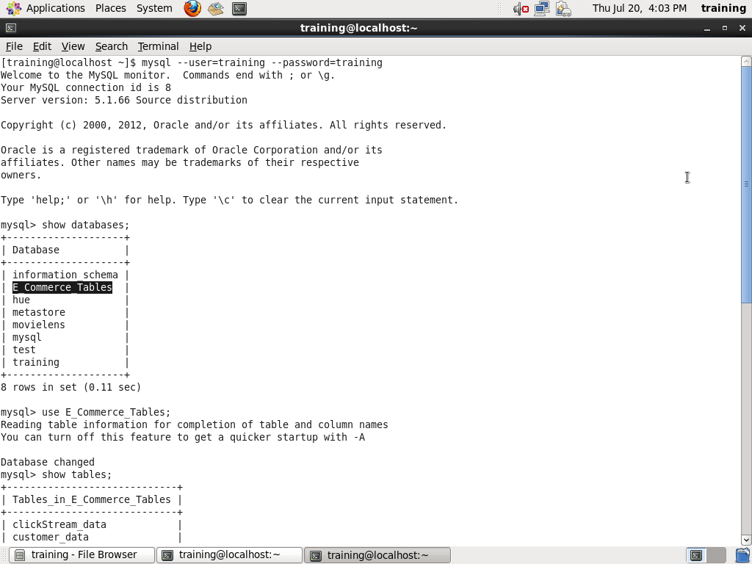
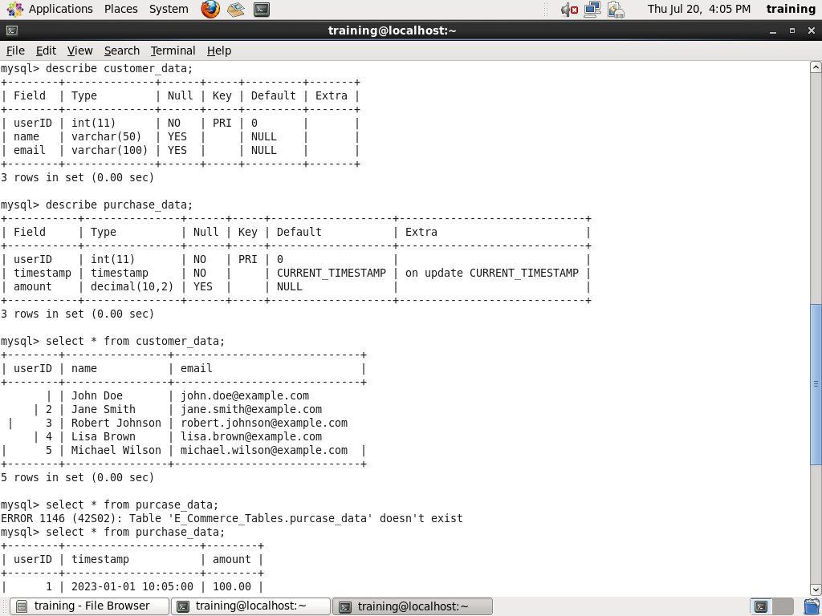
Mysql commands as 1st output.

Slide 5
Commands
OUTPUT 1 . sqoop import \> --connect jdbc:mysql://localhost/E_Commerce_Tables \> --table clickStream_data --fields-terminated-by ',' \> --username training --password training. sqoop import \> --connect jdbc:mysql://localhost/E_Commerce_Tables \> --table clickStream_data --fields-terminated-by ',' \> --username training --password training.. sqoop import --connect jdbc:mysql://localhost/E_Commerce_Tables --table purchase_data --fields-terminated-by ',' --username training --password training

Slide 6
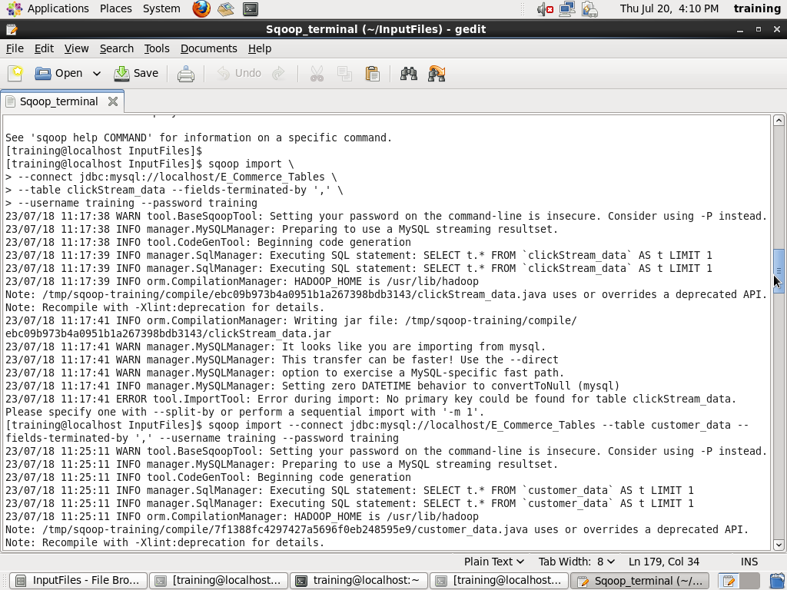
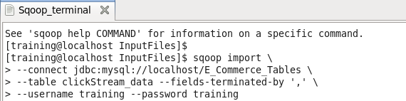
Sqoop commands as 2nd output.
Import commands
Running command

Slide 7
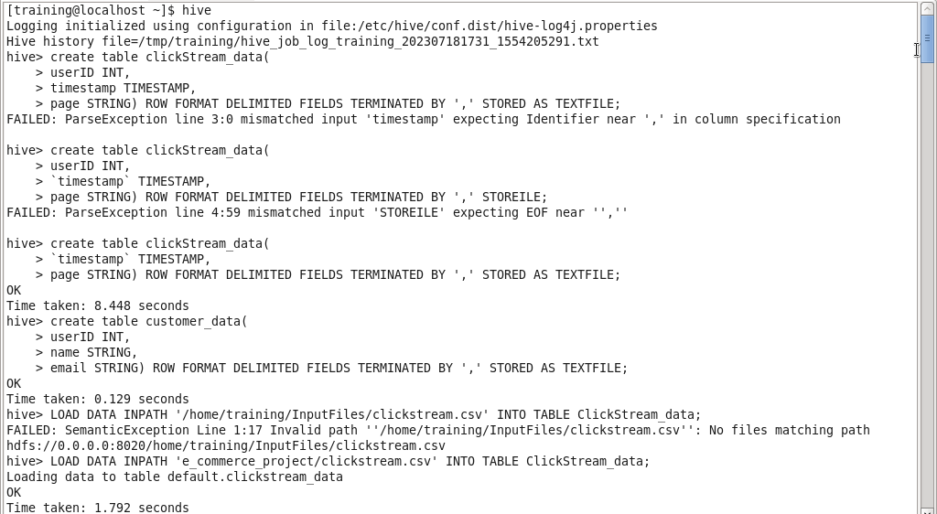
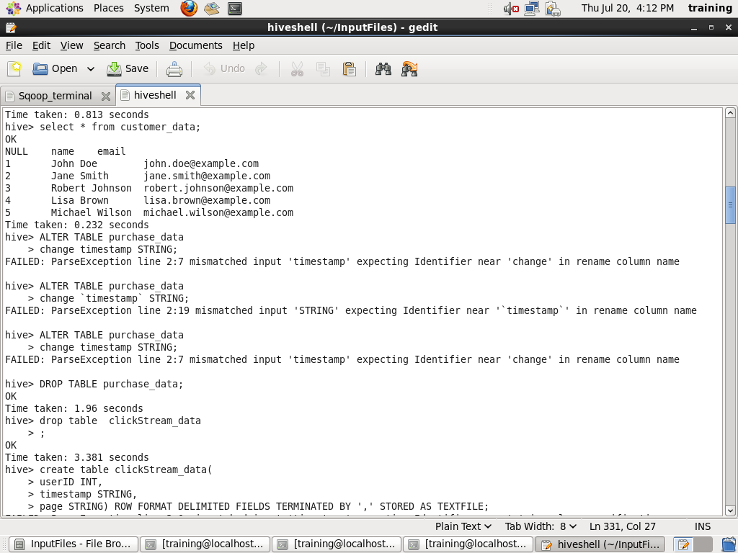
Hive commands as 3rd output

Slide 8
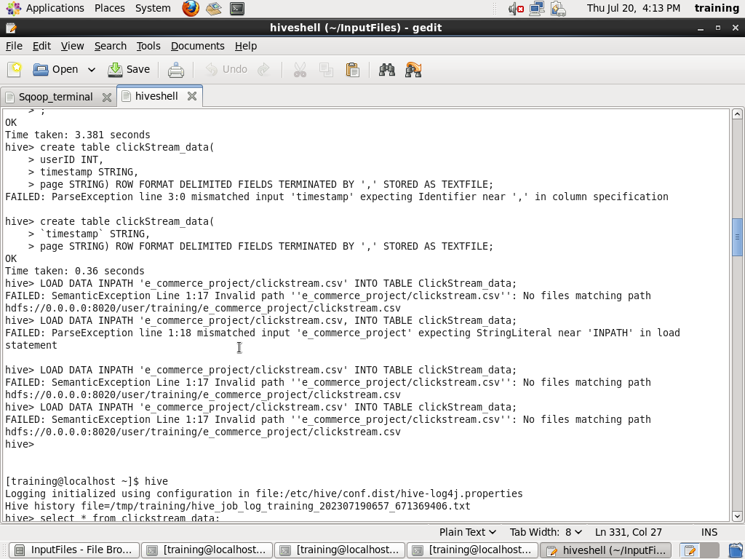
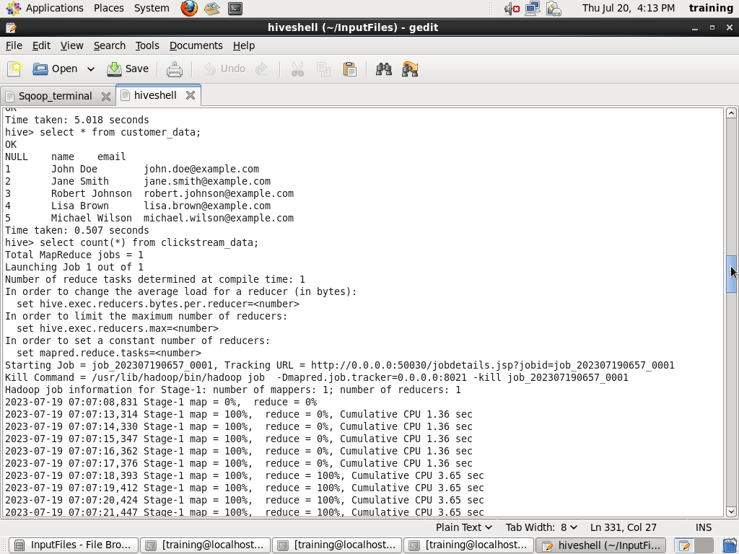

Slide 9
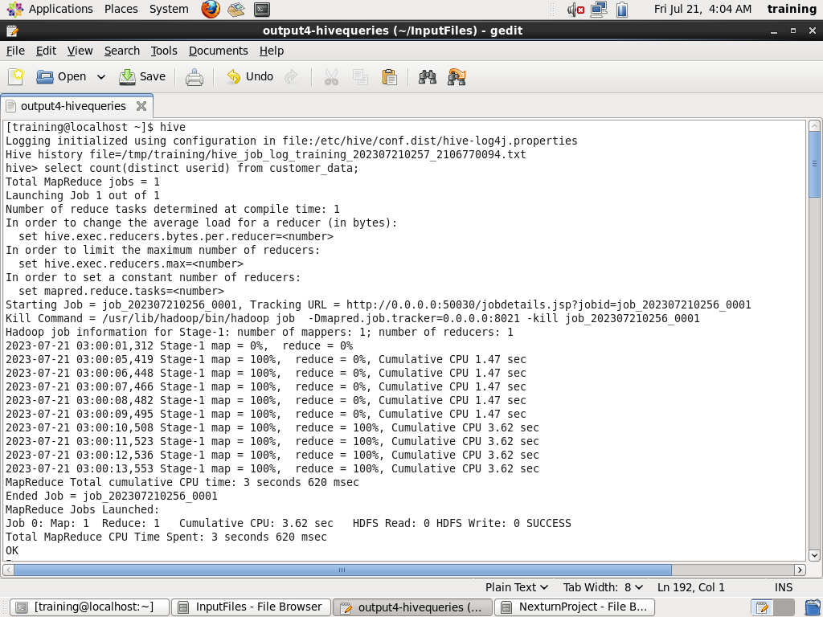
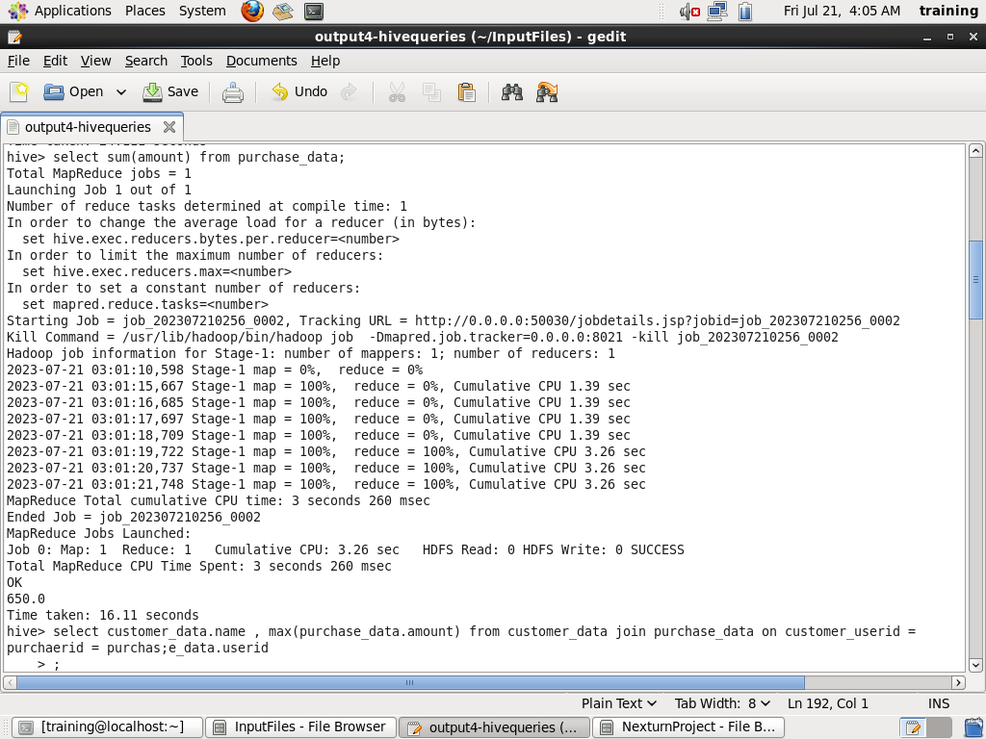
Hive query as 4th output

Slide 10
